Slide 1
What happened on 3/11 in Japan?
Earthquakes and tsunamis
How do they occur?
Can we predict them?
How can we mitigate the damage?
Shun-ichiro Karato
Yale University
Department of Geology & Geophysics

Slide 2
Summary
2011 Tohoku-Kanto earthquake was the largest earthquake in the history of Japan (4th largest in the world) (more than ~200 Billion $ damage).
Earthquakes in the oceanic region generate tsunamis.
Earthquakes occur due to slow motions of solid Earth (mantle convection) → some regularities
Earthquake occurs by faulting
Fault properties are heterogeneous → earthquakes have “personality” → difficulties in (short-term) prediction
Monitoring (and interpretation in terms of models) will help earthquake prediction in some cases.
Short-term warning reduces the damage.

Slide 3
What happened on 3/11/2011?
How to characterize earthquakes?
  What is the “magnitude” of an earthquake?
  How often do big quakes occur?
  How big is the 3/11 earthquake compared to others?
Where do earthquakes occur?
When do earthquakes occur?
Efforts toward earthquake prediction or forecasting

Slide 4
Historical earthquakes in Japan

Slide 5
A large fault (~500 km x 150 km), more than 20 m displacement

Slide 6
Land moved more than 3 m in some places (near Sendai).

Slide 7
Shocks were felt throughout Japan.

Slide 8
Tsunami （津波）
(model) (observations)

Slide 9
What is an earthquake?
Why do we have earthquakes?
What is the “magnitude” of an earthquake?
  How big was the earthquake on 3/11/2011 among other “megaquakes”?
How does an earthquake generate “tsunami”?
Where do earthquakes occur, and how often?
  Earthquake prediction or forecast
How does a seismic wave propagate?
How can we mitigate seismic hazard?

Slide 10
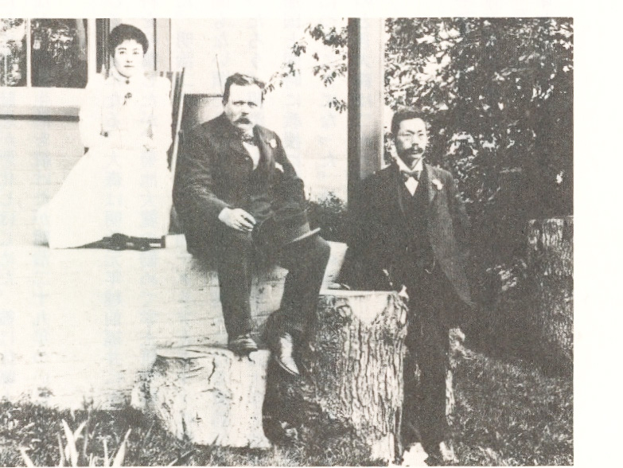
Seismology in Japan and in the world
1880: the first seismometer (Milne, Ewing) [in Japan]
1880: the first Seismological Society in the world [in Japan]
1906: San Francisco EQ → US seismology
1923: Kanto EQ → Japanese seismology (1925:
Earthquake Research Institute, University of Tokyo)
1935-1942: “magnitude” (Richter scale)
~1960: earthquake = fault motion (Honda, Maruyama)
1965: “seismic moment” (Aki)
~1970-: focal mechanisms (Kanamori)
1972: dilatancy model of an earthquake (Scholz)
1976 “seismic tomography (CAT scan)” (Aki)
1979: classification of earthquakes (Uyeda-Kanamori)

Slide 11
Earthquake Prediction Program in Japan
1891: Nobi earthquake→ “Committee on earthquake disaster prevention”
1923: Kanto earthquakes → Earthquake Research Institute
1962: “Earthquake Prediction Blueprint”
1965-1998: “Earthquake Prediction Program”
1999: “A New Blueprint”
  model ←→ monitoring

Slide 12
Where do earthquakes occur?

Slide 13
What is the “magnitude” of an earthquake?
Log (maximum amplitude) at a certain distance (100 km) = magnitude

Slide 14
San Francisco 1906 7.9
Kanto 1923 7.9
Hanshin 1995 6.9

Slide 15
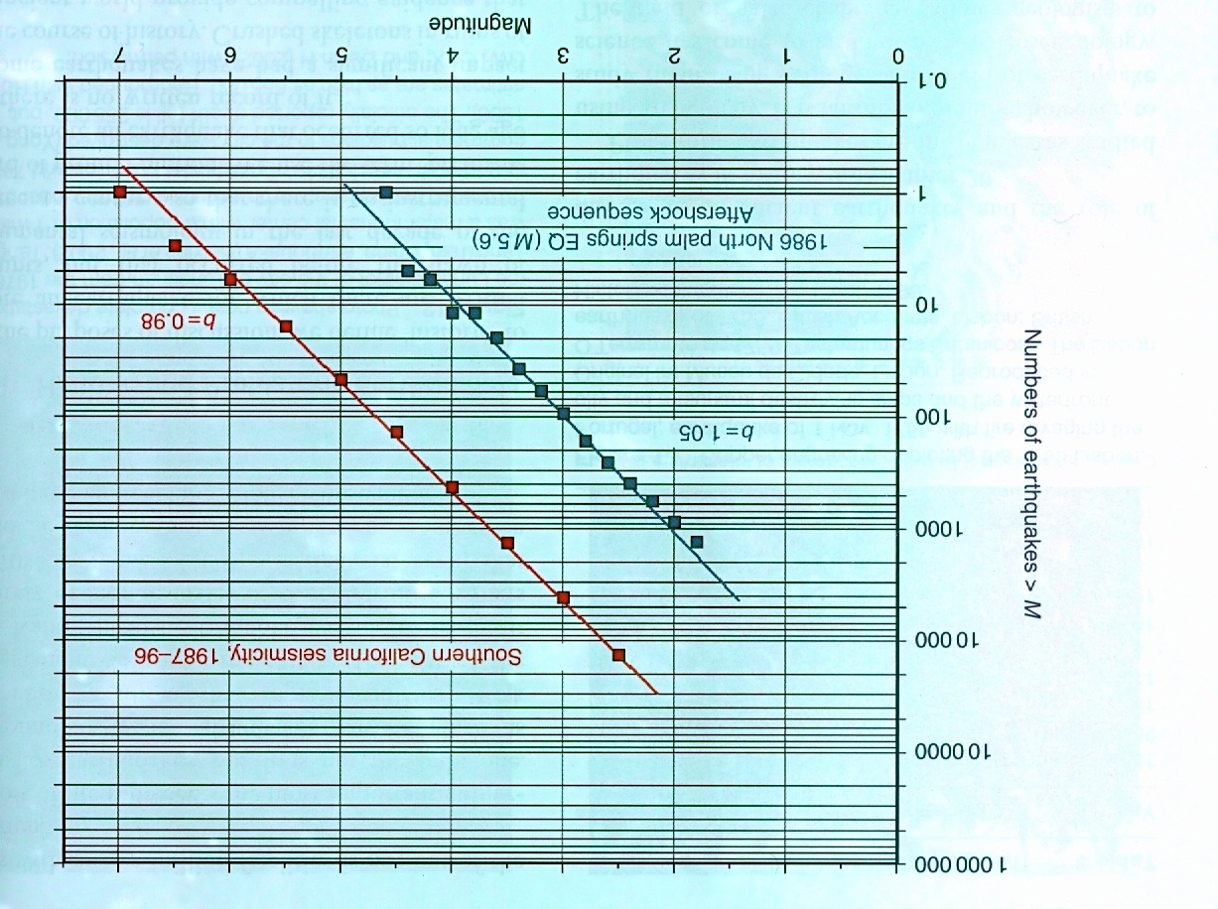
numbers
magnitude
Large earthquakes are rare.

Slide 16
magnitude and energy
Chile (1960)
Tohoku-Kanto (2011)
[Sumatra (2004)]
San Francisco (1906)
Kanto (1923)
Hanshin (1995)

Slide 17
Where and when do earthquakes occur?

Slide 18
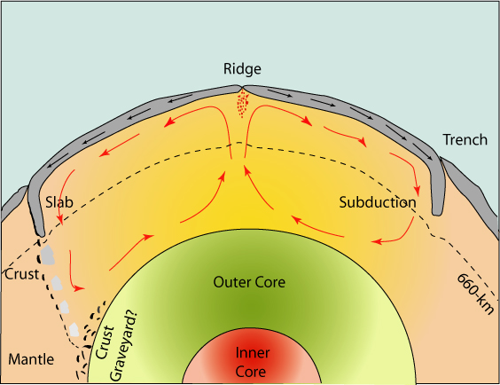
Earthquakes are generated by the stress caused by a material circulation in the Earth (mantle convection).

Slide 19
How does an earthquake occur?
How does it generate a tsunami?

Slide 20

Tsunami propagation
Tsunami can propagate long way.
Tsunami can be amplified near the coast.

Slide 21
Challenges in earthquake prediction
A difficult problem: Many factors affect the way in which earthquakes are generated.
  Basic causes (general models)
  Mechanics of faults
  Detailed description (monitoring)
Long-term prediction
Short-term prediction
  most important, most difficult

Slide 22
Long-term prediction
Classification of earthquakes
Systematics in earthquake activities

Slide 23
Where do earthquakes occur?

Slide 24
Plate boundaries in and around Japan

Slide 25
Some regularities (where?)
Seismic gap hypothesis
Mogi (1979)

Slide 26
Challenges in predicting when
There are some gross rules: seismic gaps, quasi-periodicity.
But earthquakes do not always follow the “rules”.
→ Some successes but many failures

Slide 27
Successes and failures
China (1975-1976)
  successful prediction in Haicheng 海城(1975) and failure of prediction in Tanshang 唐山(1976)
Haicheng: Clear short-term precursor, Tanshang: weak long-term “precursor (?)”

Slide 28
Some regularities (When? )
Parkfield, CA, USA
Earthquakes occurred regularly, but an earthquake expected in 1993
occurred in 2004.

Slide 29
Tohoku-Kanto versus Sumatra
Tohoku-Kanto
Sumatra

Slide 30
Challenges in predicting when
There are some gross rules: seismic gaps, quasi-periodicity.
But earthquakes do not always follow the “rules”.
  Heterogeneity in the fault structures → “personality” in earthquakes
  Need to characterize individual faults

Slide 31
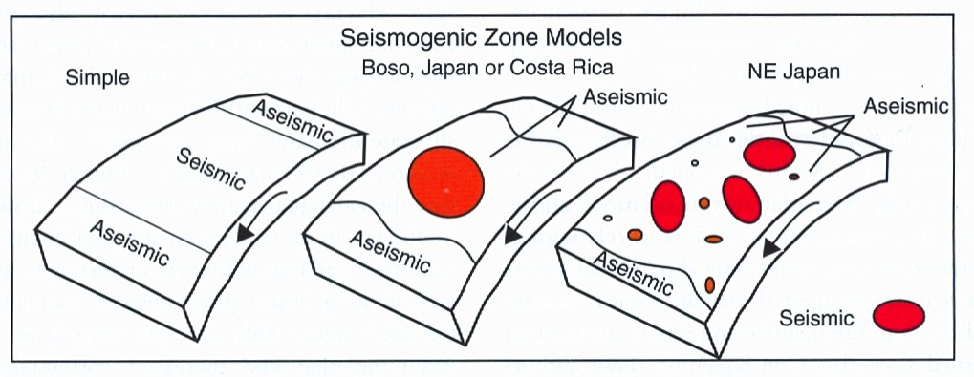
A key concept in characterizing the fault:
“asperity” (stuck region)
Fault has strongly stuck regions (asperities) as well as smoothly
moving regions. → An earthquake occurs when a stuck area is broken.

Slide 32
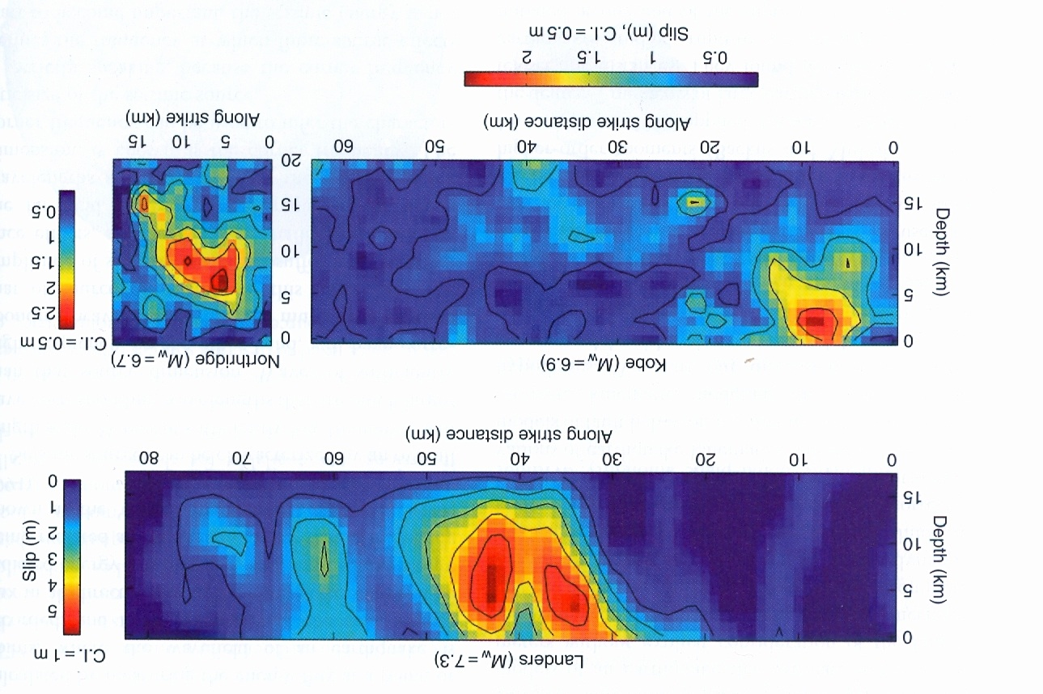
Remote sensing of fault motion
(CAT scan of a fault motion)

Slide 33
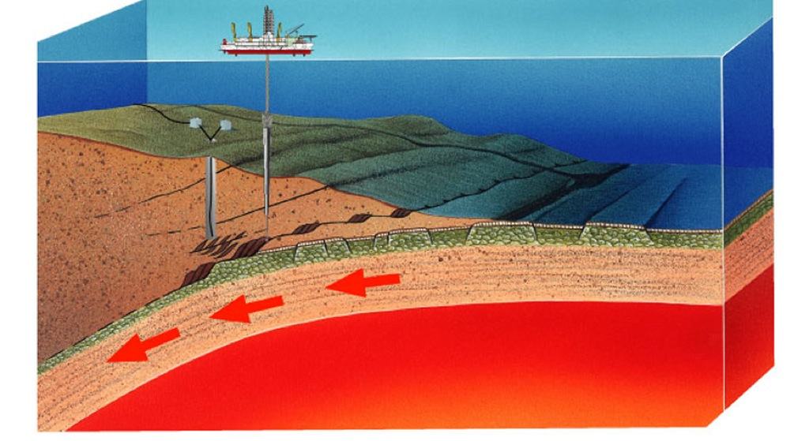
Direct sampling from faults
(biopsy of a fault)
San Andreas fault (USA)
Nankai trough (Japan)

Slide 34
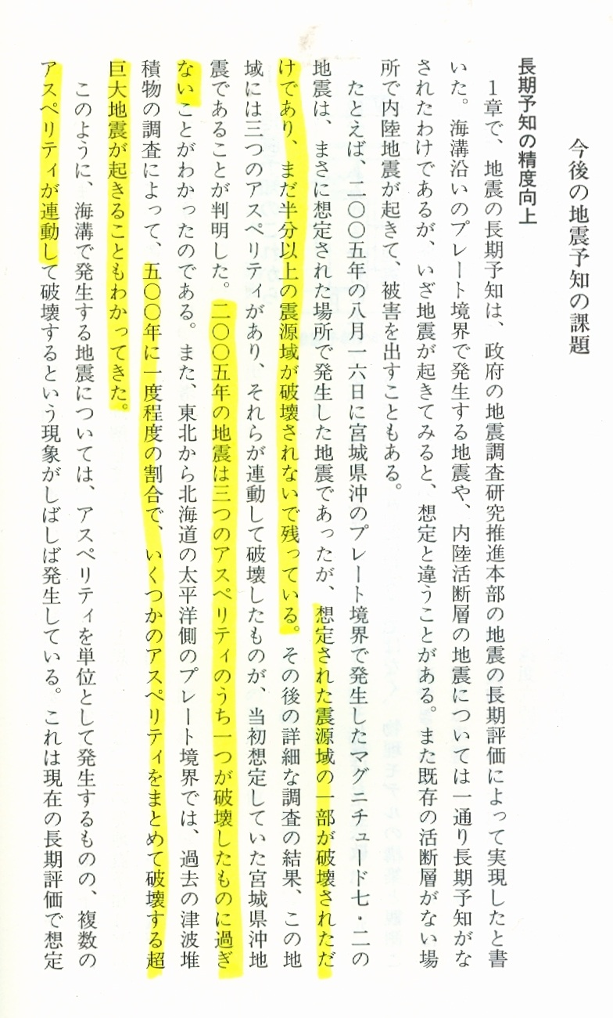
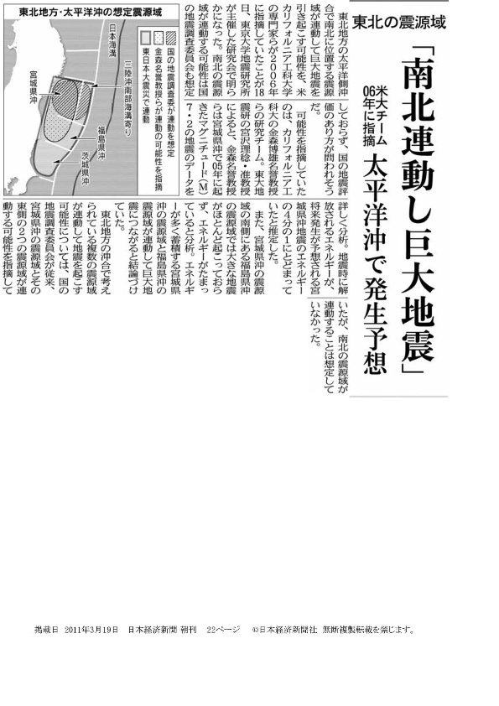
A large earthquake in Tohoku was expected

Slide 35
How to minimize the hazard?
Building
Warning
  Short-term earthquake warning
  Tsunami warning

Slide 36
Earthquake warning

Slide 37
Earthquake warning
(installed in 2006 (in Japan))

Slide 38
Summary
2011 Tohoku-Kanto earthquake was the largest earthquake in the history of Japan (4th largest in the world) (more than ~200 Billion $ damage).
Earthquakes in the oceanic region generate tsunamis.
Earthquakes occur due to slow motions of solid Earth (mantle convection) → some regularities
Earthquake occurs by faulting
Fault properties are heterogeneous → earthquakes have “personality” → difficulties in (short-term) prediction
Monitoring (and interpretation in terms of models) will help earthquake prediction in some cases.
Short-term warning reduces the damage.

Slide 40
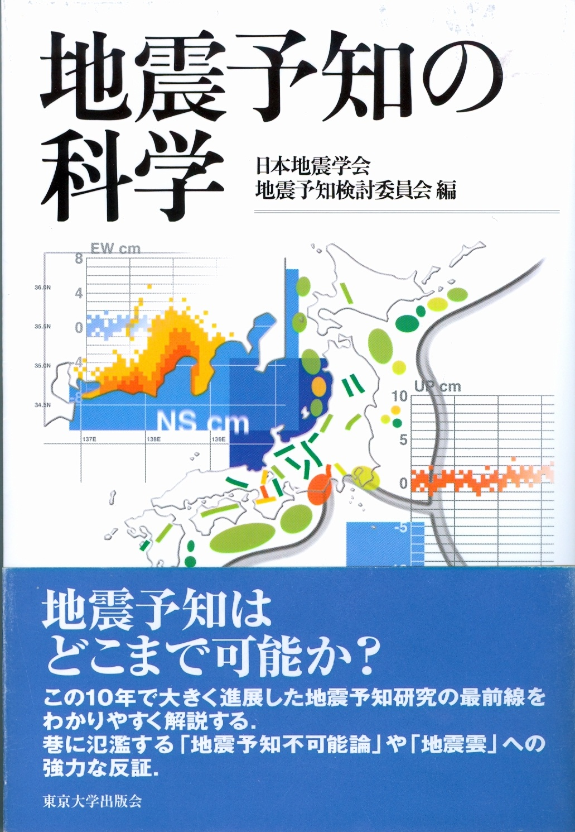

Slide 41
Precursor for the Tohoku-Kanto earthquake?

Slide 42
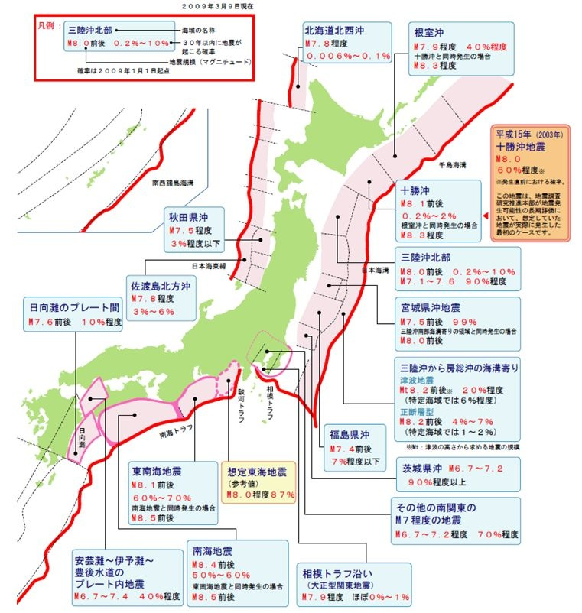
Long-term earthquake risk assessment in Japan

Slide 43
Large earthquakes since 1900

